Slide 1
Cocos2d
Jochem Van Hespen, Szilágyi István, Wouter van hecke

Slide 2

What is cocos2d?
- Open-source game framework
- Widely used
Uses aspects like:
- Scenes
- Sprites
- Actions
- Animation

Slide 3
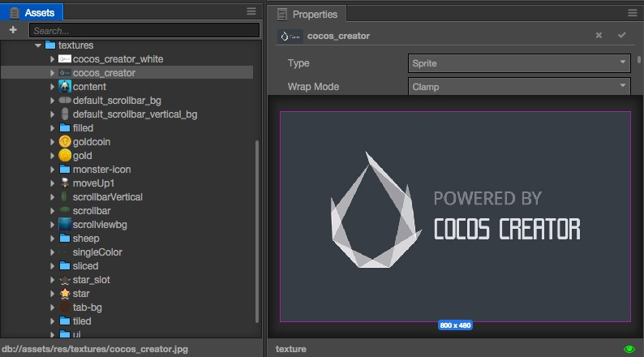
What version to use?
Cocos creator
- Complete package
- Easy to use
- Javascript
Cocos2d-x
- Hard to setup
- Needs own IDE

Slide 4

Different programming languages
JavaScript
- Full support
- Runs everywhere
- Debug in browser
- High performance
- Big API functionality
C++
- More Documentation

Slide 5


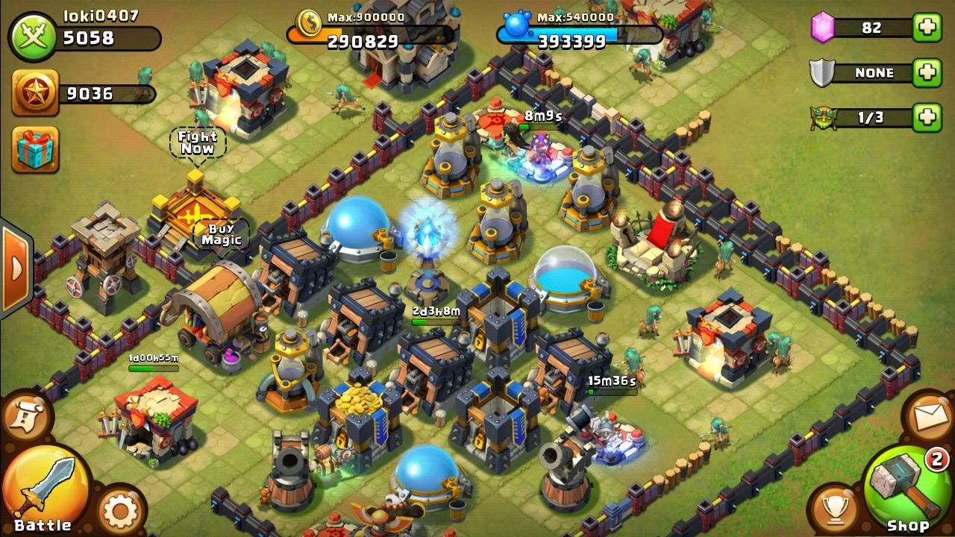
Popular games made with Cocos2d

Slide 6
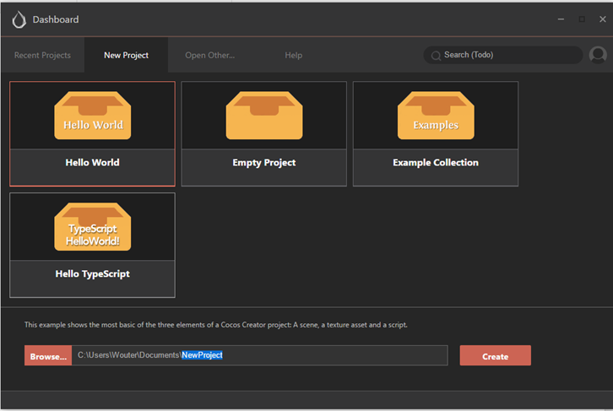
Cocos creator, basic environment
Making a new project

Slide 7
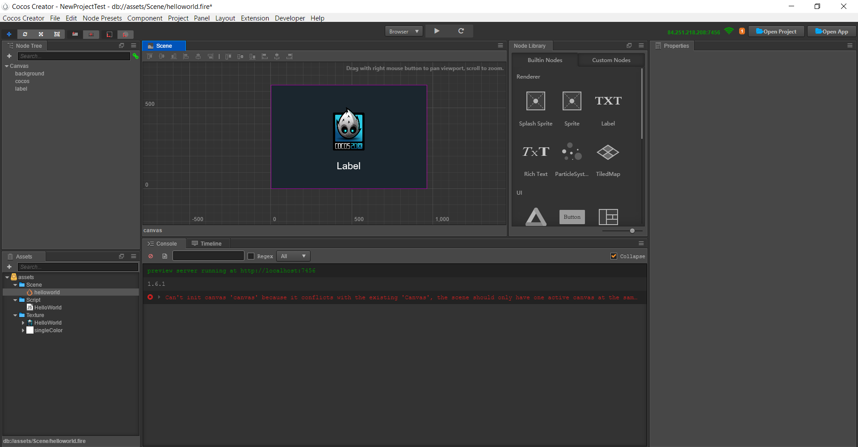
Cocos creator, basic environment

Slide 8
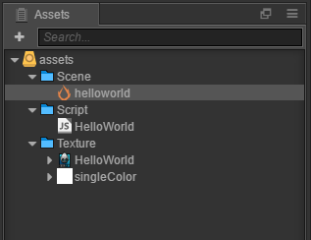
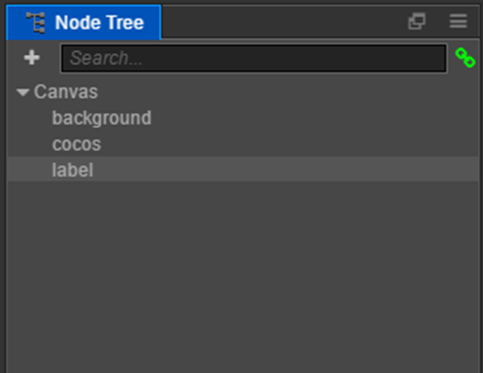
Cocos creator, basic environment
Assets

Slide 9
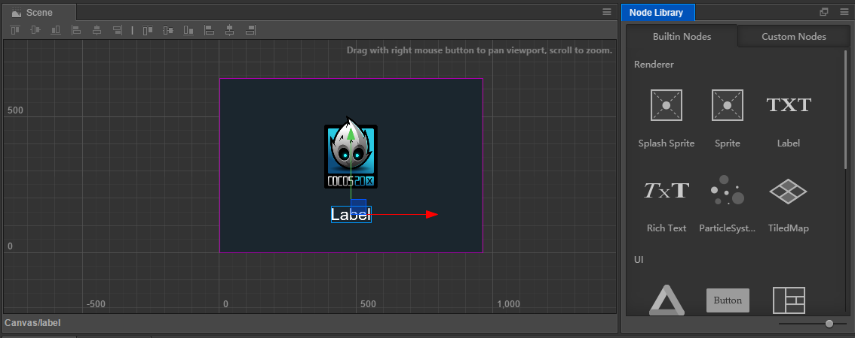
Cocos creator, basic environment

Slide 10
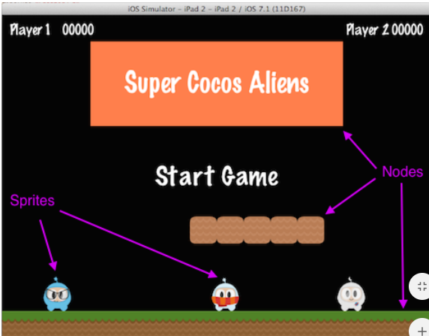
Node component

Slide 11
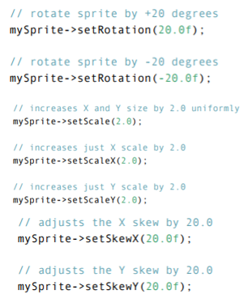

Sprites

Slide 12

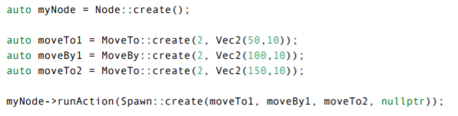
Animations

Slide 13
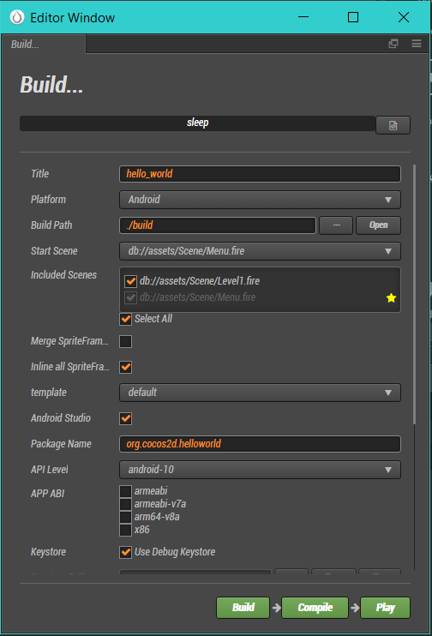
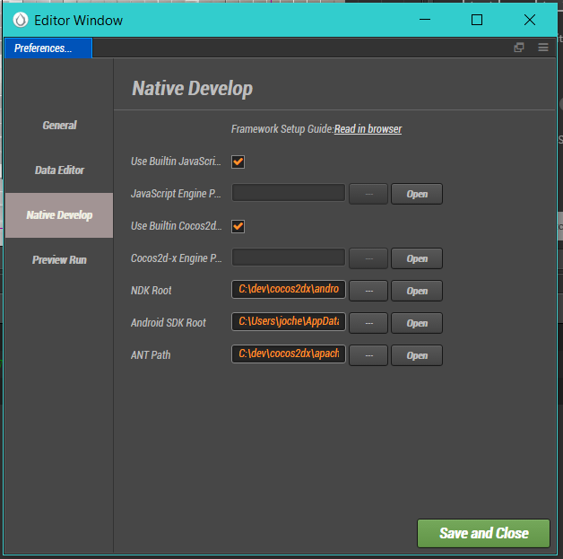
Compile the project to your device

Slide 14
Demo

